Slide 1
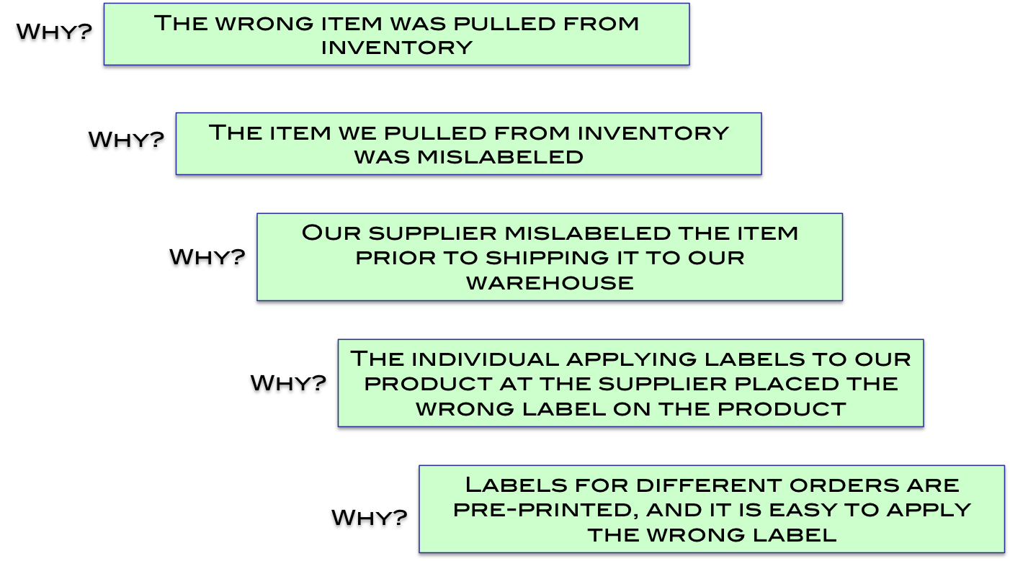
Solving the Deeper Why’s Creates Permanent Gains
Problem Statement: Wrong item shipped to customer
“Retrain our stock pickers” – almost no benefit – this solution has nothing to do with the true cause
“Inspect our inventory” – minimal benefit – applies to current stock only
“Have the supplier sort their stock to contain the problem” – very limited long-term benefit
“Conduct training at the supplier” – limited long-term benefit
“Mistake-proof the label printing and application process” – highly effective

Slide 2
5-Why Analysis – ABC Distribution Center
Problem Statement: Wrong item shipped to customer
Why?
The wrong item was pulled from inventory
Why?
The item we pulled from inventory was mislabeled
Our supplier mislabeled the item prior to shipping it to our warehouse
Why?
The individual applying labels to our product at the supplier placed the wrong label on the product
Why?
Labels for different orders are pre-printed, and it is easy to apply the wrong label
Why?

Slide 3
5-Why Analysis For Multiple Causes
Problem Statement: Downtime in Final Assembly is Averaging 22 Minutes Per Shift, Versus the 5 Minute Goal
Why?
Why?
Why?
Why?
Why?
Supplier “A” Capacity Constraint
Machine XYZ Capacity Constraint
Two of Six Stations not Functioning
Lack of Preventive Maintenance
35% of Pareto
1
Material Shortages
Suppliers not Monitoring Bin Status
Lack of Training and Internal Audit
Kan-Ban Bins Empty
14% of Pareto
Bearing Replacement Not in Preventive Maintenance Program
Missed the Bearings in Original PM Needs Assessment
ABC Machine Down for Constant Adjustments
Alignment Problems
Bearings Worn
2

Slide 4
5-Why Analysis For Multiple Causes
Problem Statement: Downtime in Final Assembly is Averaging 22 Minutes Per Shift, Versus the 5 Minute Goal
Why?
Why?
Why?
Why?
Why?
AJ – 1/27 Target
Supplier “A” Capacity Constraint
Machine XYZ Capacity Constraint
Two of Six Stations not Functioning
Lack of Preventive Maintenance
35% of Pareto
1
Material Shortages
Suppliers not Monitoring Bin Status
Lack of Training and Internal Audit
Kan-Ban Bins Empty
Complete Review of PM System (JB) – 3/12 Report-Out Scheduled
Need Owner & Target Date
14% of Pareto
Bearing Replacement Not in Preventive Maintenance Program
Missed the Bearings in Original PM Needs Assessment
ABC Machine Down for Constant Adjustments
Alignment Problems
Bearings Worn
2

